Slide 1

Focus Flow tracker
Alex Rother | Davyn Mengeling | Jeffrey Wiggs | Siddh Patel | Manihams Suraparaju

Slide 2
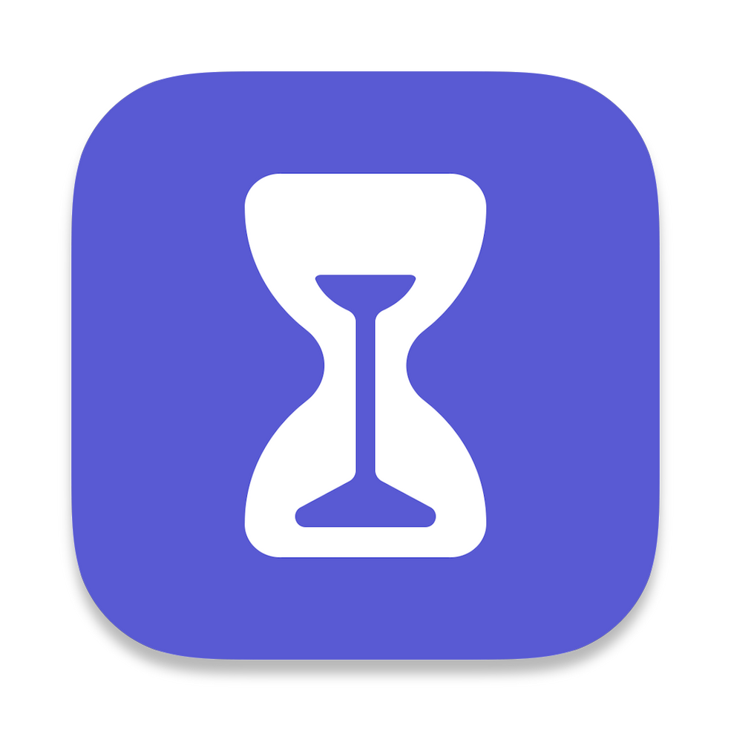

Purpose
Focus Flow Tracker is a Chrome extension we’ve developed. Similarly to the screentime feature on iPhone, it’s designed to track where you’ve been, limit distractions, and boost productivity.

Slide 3
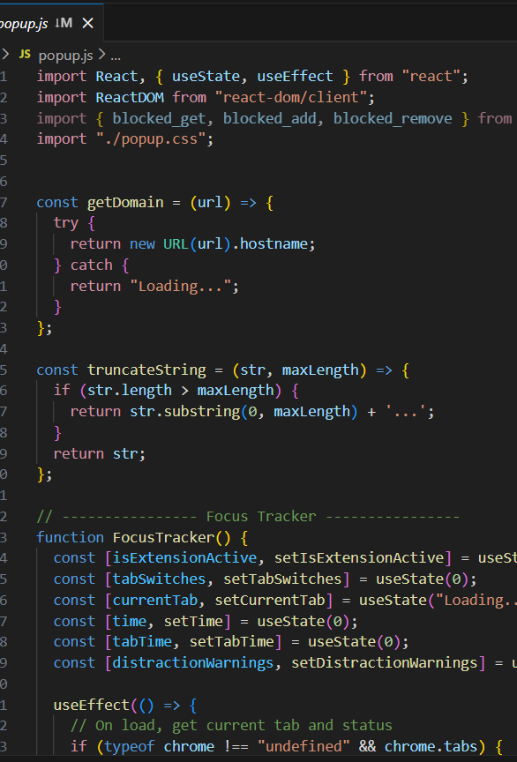
How did we make our project?
Our Chrome extension was built with React and contains a mix of JavaScript, HTML, and CSS code.

Slide 4
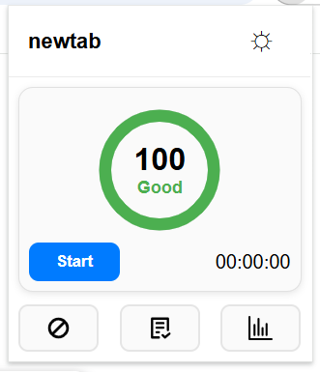
What does focus flow tracker do?
Tab Tracking
Timer
Site Blocker
Ad Blocker
Notepad
Stats
Distraction Score
Current Tab Display
Light/Dark Mode

Slide 5
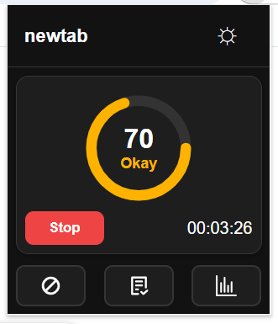
tracker
// ---------------- Distraction Score ----------------
function DistractionScore({ time, tabSwitches, distractionWarnings }) {
const timeMinutes = Math.max(time / 60000, 0.1);
const a = 0.25;
const b = 3;
const score = Math.round(
100 * (timeMinutes / (timeMinutes + (a * tabSwitches + b * distractionWarnings)))
);

Slide 6
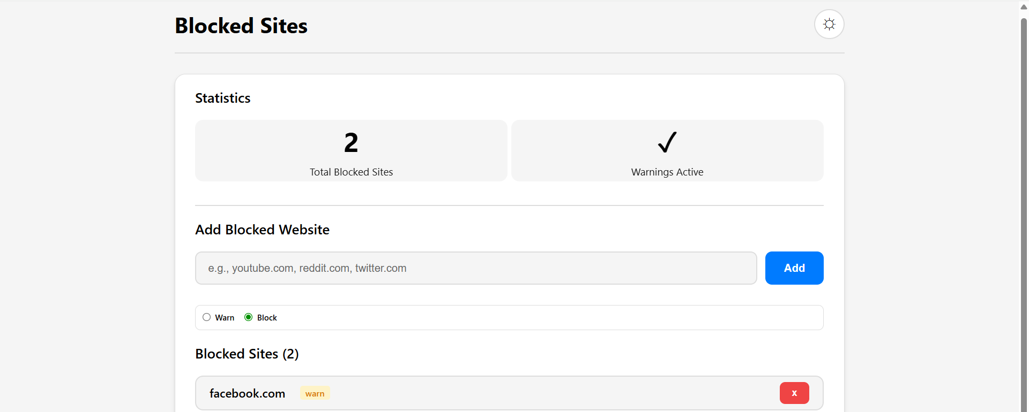
Site blocker

Slide 7
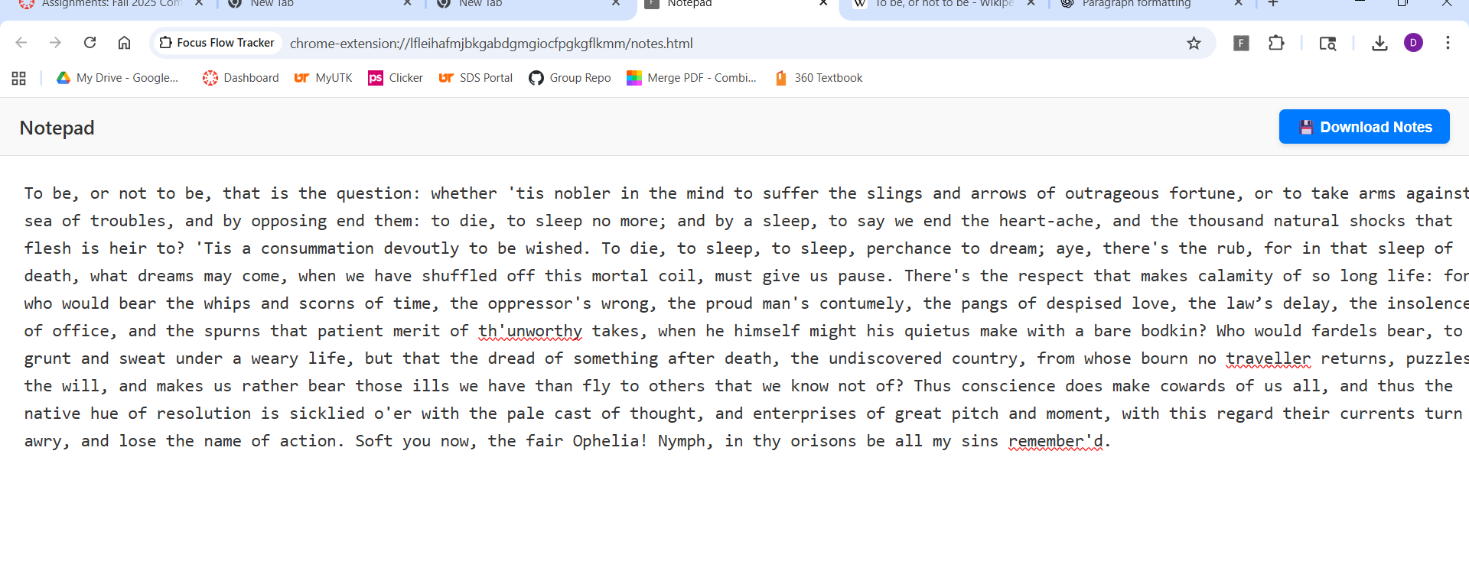
Notepad

Slide 8
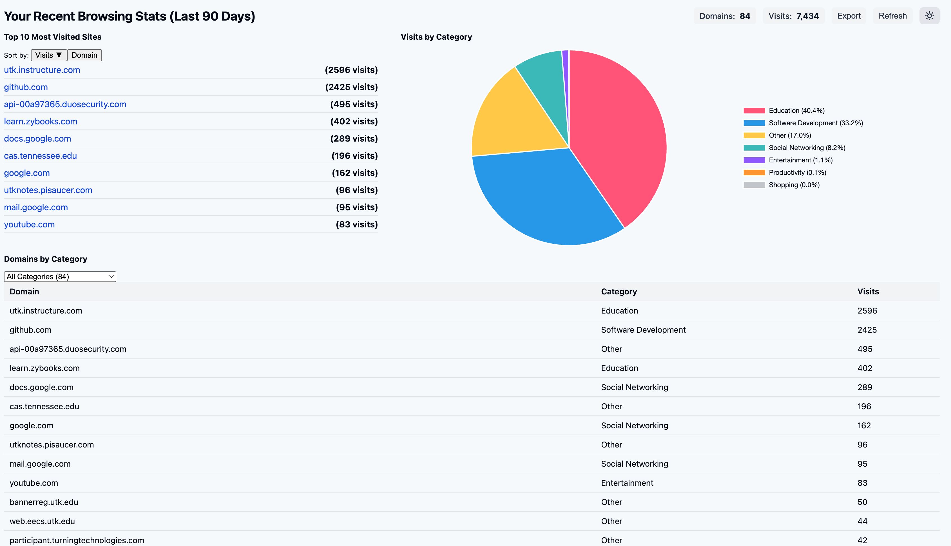
STATS

Slide 9
Time for a demo!

Slide 10

Questions?

